Slide 1

EduPlay

Slide 2

Table of Contents
01
02
03
04
Problem Statement
Problem Validation
Solution Overview
Solution Definition
How did we come up with this idea?
Here you could describe the topic of the section
Here you could describe the topic of the section
Here you could describe the topic of the section

Slide 3


Our Team
Sean Lam
Year 3 SIS Student
Bang
Year 3 SIS Student

Slide 4


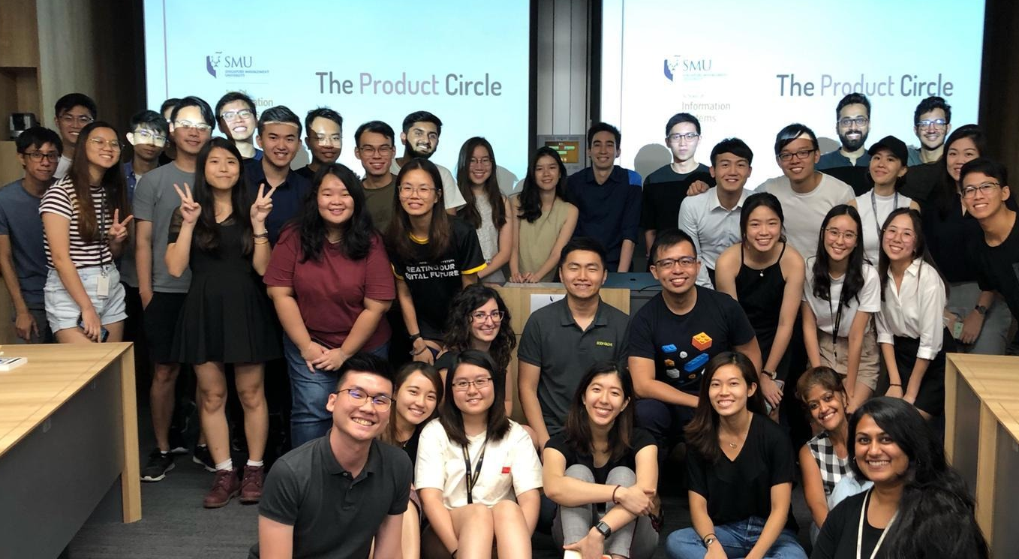
Our Team
Mentor Cher Han (Cherps)
Product Manager, Reactor
The Product Circle
Unleash the product hero inside you

Slide 5

Product Vision
Product Mission
A world where educators can engage students with ease, where teachers and students are enjoying classes and don’t want the lesson to end.
A tool to enable students to learn better, and empower educators to teach better.

Slide 6

Problem Statement
Educators find it difficult to keep young students engaged and motivated during lessons, because of their short attention span.

Slide 7



Target Personas
PSLE Tutors
Primary School Teachers
Primary School Students

Slide 8

Problem Validation
After identifying target personas, we approach 10 educators to collect insightful data and feedback from them.

Slide 9



Interview Process
Goal
Attitude
Frustration

Slide 10
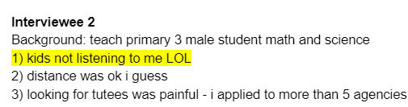
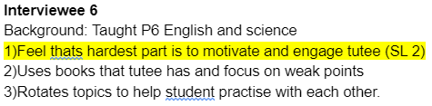
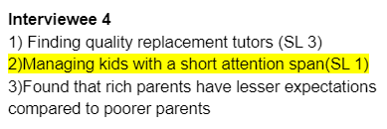
Interview Responses

Slide 11

Solution
Low content creation friction, personalised Learning Management System that incorporates gamified quiz elements with similarity and frequency learning.

Slide 12



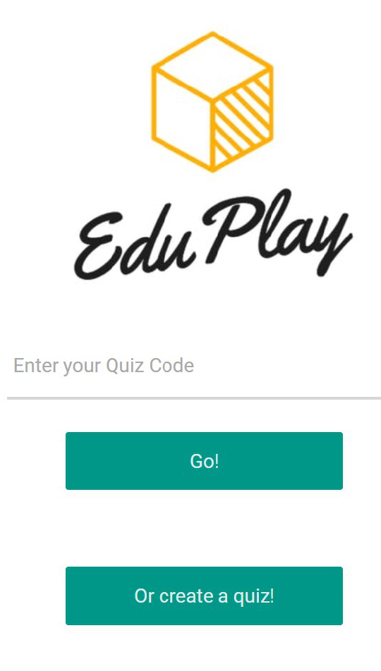
Product Overview
Auto Quiz Builder
Quiz Scheduler
After uploading questions using their camera, EduPlay will generate a unique quiz code for you.
This is the ringed one. It’s a gas giant, composed of hydrogen and helium

Slide 13
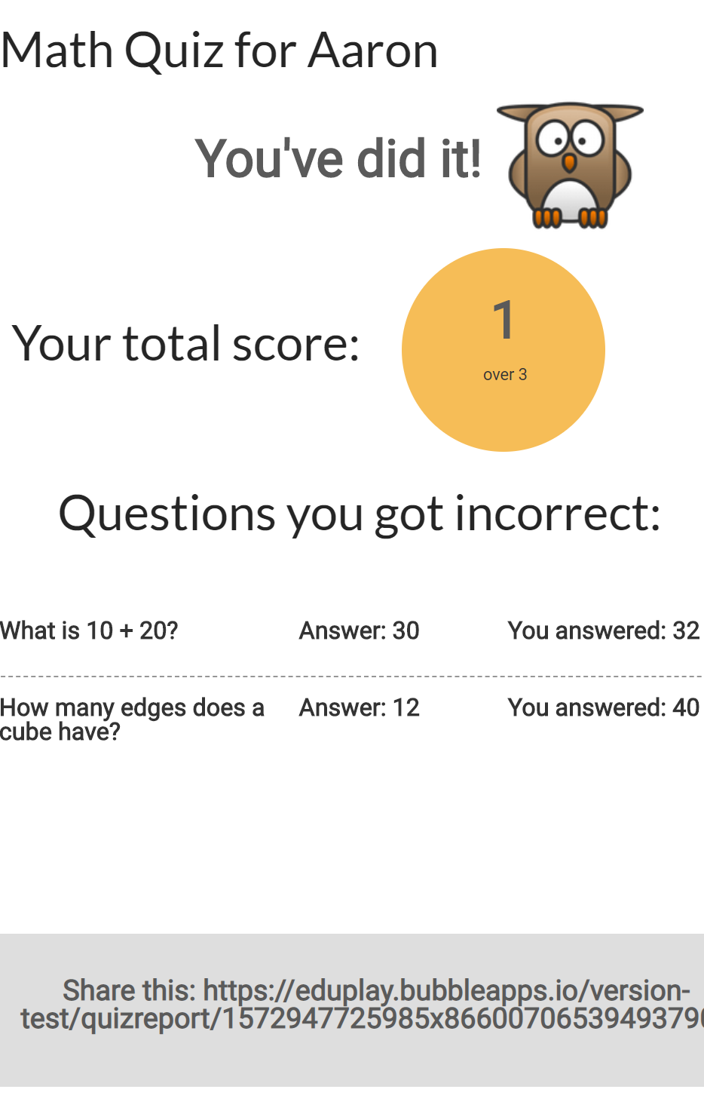
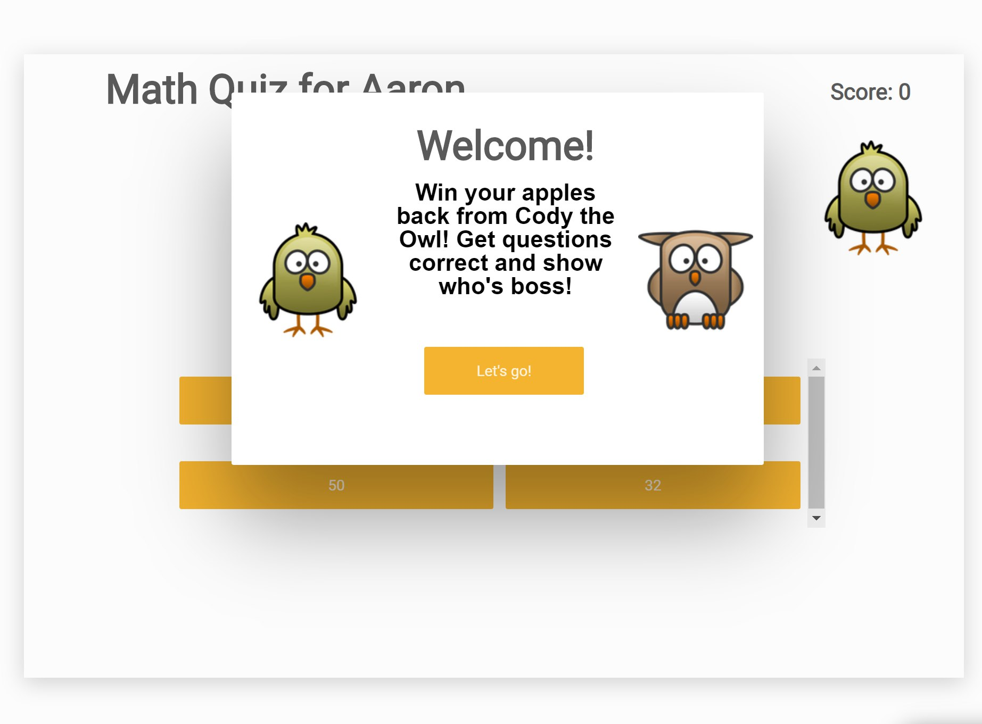
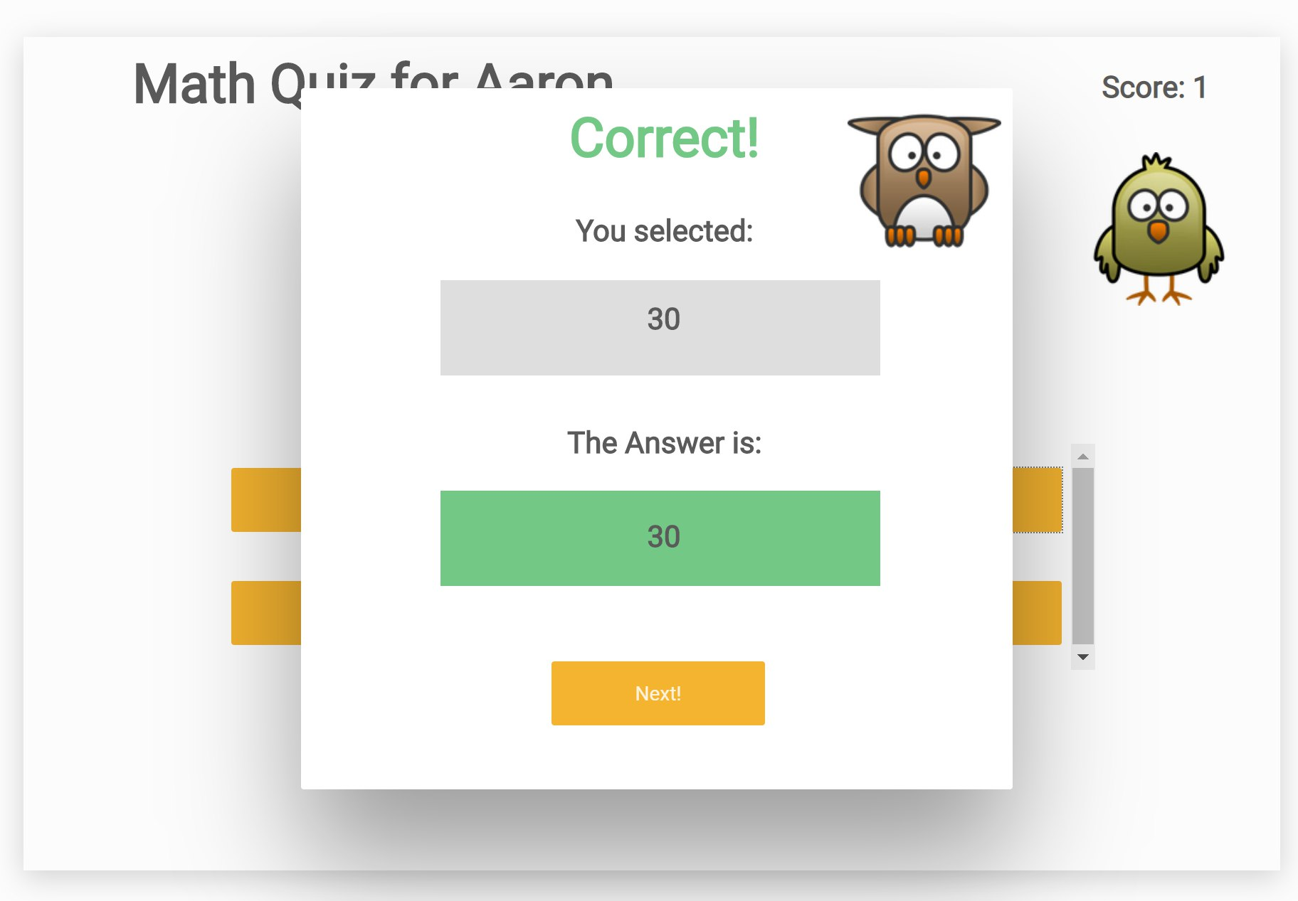
Product Overview
Gamified Quiz Experience
Auto generated questions
Quiz Report
Customised quiz experience with gamified elements to keep students engaged in play
Upcoming feature, users will be able to generate multiple Math questions by using dynamic figures
Keep track of students’ scores and questions that they get wrong

Slide 14

Product Demo

Slide 15

Solution Validation
Daily Activities
Usage metrics
Qualitative measures
Monthly metrics (long run)
Number of Quiz created
Number of Quizzes played
The number of accounts created
Conversion from trial to paid
Student’s feedback (fun level)
Parent’s feedback (report)
Tutor’s feedback (observed student engagement and learning)
The number of accounts created
Conversion from trial to paid

Slide 16

Thank you

